Slide 1
Spring Web apps. Rest. Netflix

Slide 5
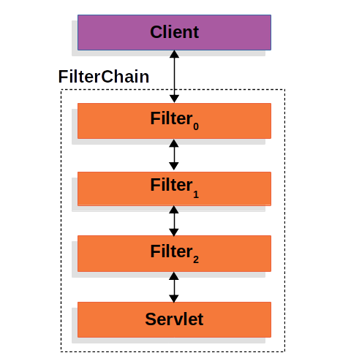
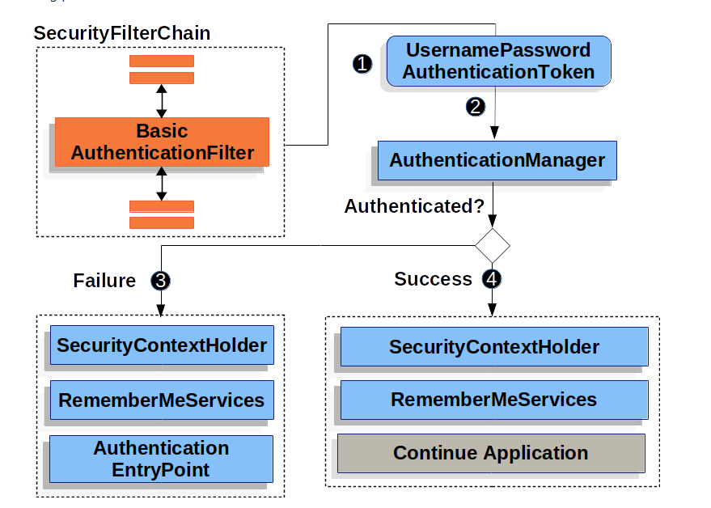

Slide 6
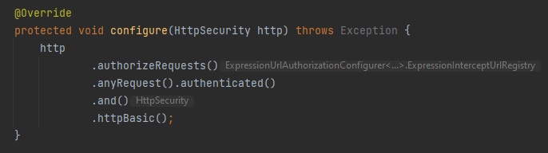
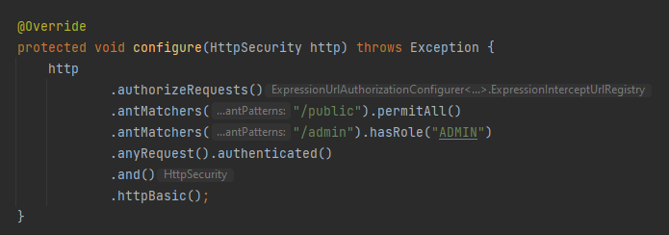

Slide 7
@Configuration @EnableWebSecurity public class WebSecurityConfig extends WebSecurityConfigurerAdapter { @Override protected void configure(HttpSecurity http) throws Exception { http .authorizeRequests() .antMatchers("/", "/home").permitAll() .and() .authorizeRequests().antMatchers("/singers/**").authenticated() .and() .formLogin() .loginPage("/login") .permitAll() .and() .logout() .permitAll(); } @Autowired public void configureGlobal(AuthenticationManagerBuilder auth) throws Exception { PasswordEncoder passwordEncoder = new BCryptPasswordEncoder(); auth .inMemoryAuthentication() .passwordEncoder(passwordEncoder) .withUser("user").password(passwordEncoder.encode("user")).roles("USER"); } }
@Configuration @EnableWebMvc public class MvcConfig implements WebMvcConfigurer { @Override public void addViewControllers(ViewControllerRegistry registry) { registry.addViewController("/index").setViewName("index"); registry.addViewController("/").setViewName("index"); registry.addViewController("/login").setViewName("login"); } @Override public void addFormatters(FormatterRegistry formatterRegistry) { formatterRegistry.addFormatter(dateFormatter()); } @Bean public DateFormatter dateFormatter() { return new DateFormatter(); } }

Slide 8
@Controller @RequestMapping(value = "/singers") public class SingerController { private final Logger logger = LoggerFactory.getLogger(SingerController.class); @Autowired SingerService singerService; @GetMapping public String list(Model uiModel) { logger.info("Listing singers"); List<Singer> singers = singerService.findAll(); uiModel.addAttribute("singers", singers); logger.info("No. of singers: " + singers.size()); return "singers"; } @GetMapping(value = "/{id}") public String show(@PathVariable("id") Long id, Model uiModel) { Singer singer = singerService.findById(id); uiModel.addAttribute("singer", singer); return "show"; } @GetMapping(value = "/edit/{id}") public String updateForm(@PathVariable Long id, Model model) { model.addAttribute("singer", singerService.findById(id)); return "update"; } @GetMapping(value = "/new") public String createForm(Model uiModel) { Singer singer = new Singer(); uiModel.addAttribute("singer", singer); return "update"; } @PostMapping public String saveSinger(@Valid Singer singer) { singerService.save(singer); return "redirect:/singers/" + singer.getId(); } }
@Service public class SingerServiceImpl implements SingerService { private SingerRepository singerRepository; @Override public List<Singer> findAll() { return Lists.newArrayList(singerRepository.findAll()); } @Override public Singer findById(Long id) { return singerRepository.findById(id).get(); }
public interface SingerRepository extends CrudRepository<Singer, Long> { }

Slide 9
@RestController @RequestMapping(value = "/singer") public class SingerController { final Logger logger = LoggerFactory.getLogger(SingerController.class); @Autowired private SingerService singerService; @ResponseStatus(HttpStatus.OK) @GetMapping(value = "/listdata") public List<Singer> listData() { return singerService.findAll(); } @ResponseStatus(HttpStatus.OK) @GetMapping(value = "/{id}") public Singer findSingerById(@PathVariable Long id) { return singerService.findById(id); } @ResponseStatus(HttpStatus.CREATED) @PostMapping(value="/") public Singer create(@RequestBody Singer singer) { singerService.save(singer); logger.info("Singer created successfully with info: " + singer); return singer; } @ResponseStatus(HttpStatus.OK) @PutMapping(value="/{id}") public void update(@RequestBody Singer singer, @PathVariable Long id) { logger.info("Updating singer: " + singer); singerService.save(singer); } @ResponseStatus(HttpStatus.NO_CONTENT) @DeleteMapping(value="/{id}") public void delete(@PathVariable Long id) { Singer singer = singerService.findById(id); singerService.delete(singer); } }
@Service("singerService") @Transactional public class SingerServiceImpl implements SingerService { @Autowired private SingerRepository singerRepository; @Override @Transactional(readOnly = true) public List<Singer> findAll() { return Lists.newArrayList(singerRepository.findAll()); } @Override @Transactional(readOnly = true) public List<Singer> findByFirstName(String firstName) { return singerRepository.findByFirstName(firstName); } @Override @Transactional(readOnly = true) public Singer findById(Long id) { return singerRepository.findById(id).get(); } @Override public Singer save(Singer singer) { return singerRepository.save(singer); } @Override public void delete(Singer singer) { singerRepository.delete(singer); } }
public interface SingerRepository extends CrudRepository<Singer, Long> { List<Singer> findByFirstName(String firstName); }

Slide 10
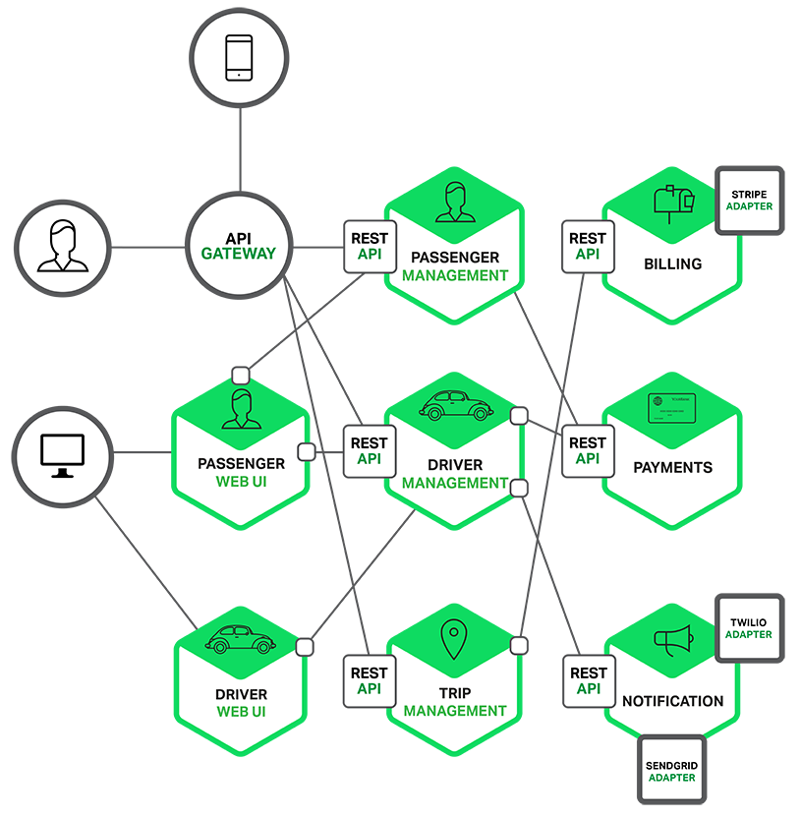
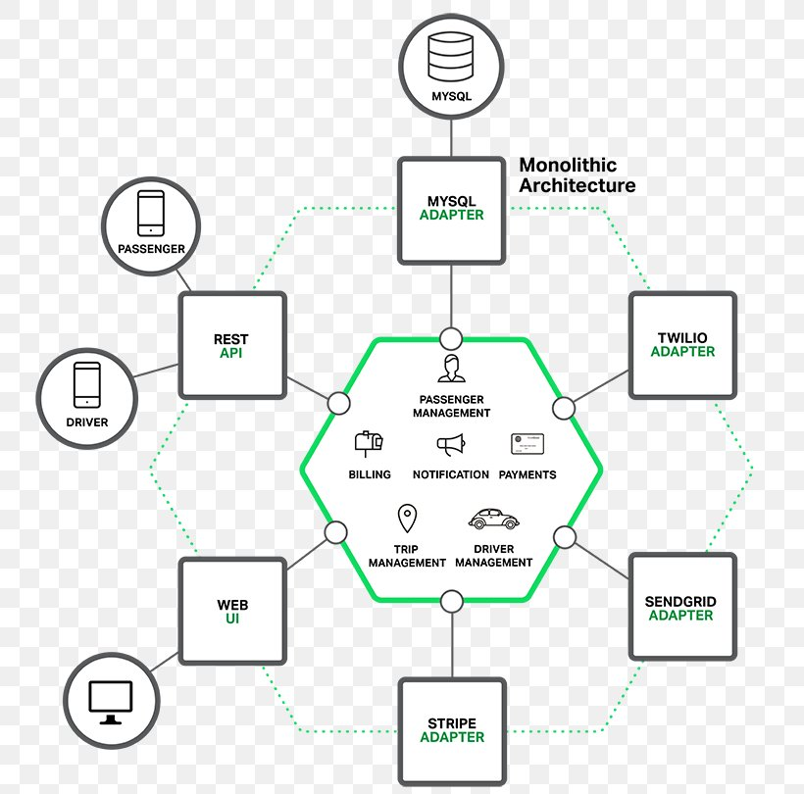

Slide 11
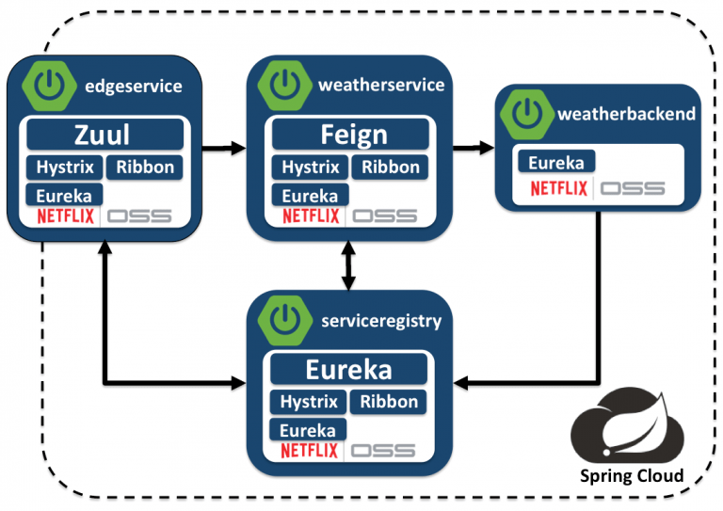

Slide 12
Spring netflix
@RestController @RequestMapping(“/users/{id}/statistic”) public class StatisticsController { @Autowired StatisticsService statisticsService; public List<UserStatisticModel> getStatistic(@PathVariable String id) { List<UserStatisticModel> statisticsList = statisticsService.getAlbums(id); return statisticsList; } }
@SpringBootApplication @EnableEurekaServer public class EurekaServerApplication { public static void main(String[] args) { SpringApplication.run(EurekaServerApplication.class, args); } }
@Service public class UsersServiceImpl implements UsersService { @Autowired ServiceFeignClient serviceFeignClient; …. List<AlbumResponseModel> albumsList = serviceFeignClient.getStatistic(userId); …. }
@FeignClient(name = “library”) public interface ServiceFeignClient { @GetMapping(“/users/${id}/statistic”) public List<UserStatisticModel> getStatistic(@PathVariable String id); }

